Slide 1

Lost & Found Portal

Slide 2
Introduction
A lost and found portal is a digital system designed to facilitate the reporting, tracking, and retrieval of lost and found items.
It streamlines the process, making it easier for individuals to report lost possessions and for staff to match them with found items, ultimately speeding up the recovery process.

Slide 3
Lost and Found Command-Line Portal
Objective
To create a command-line portal for handling lost and found items.
Features
Add lost items, report found items, and search for matches.
User-Friendly
A simple and intuitive interface for smooth navigation.

Slide 4
Code Overview
Menu-Driven Loop
Continuous loop for options and user input.
Function calls
Directs to functions for different user selections.
Ease of use
Simple switch-based navigation for all users.

Slide 5

Core Functionalities
Users can input details for items they have lost.
Add Found Item
Registration of found items helps users recover possessions.
Search/Match Items
An effective search matches items based on keywords.
Menu Interface
Prominent menu options guide users effortlessly.

Slide 6
Algorithm for Lost and Found Portal
Step1 Start
Step2 Initialize necessary data structures
Define a structure (struct) for an item with fields like:
Item ID
Item Name
Description
Location found/lost
Date
Status (Found or Lost)
Step3 Create two arrays (or linked lists):
One for Lost Items
One for Found Items
Step4 Show Menu Options:
Report Lost Item
Report Found Item
View Lost Items
View Found Items
Match Lost and Found Items
Exit

Slide 7
Step5 Based on user choice:
If Report Lost Item:
Take input for item details.
Store in Lost Items list.
If Report Found Item:
Take input for item details.
Store in Found Items list.
If View Lost Items:
Display all items in Lost Items list.
If View Found Items:
Display all items in Found Items list.
If Match Lost and Found Items:
Compare Lost and Found lists based on item name and description similarity.
Display potential matches.
If Exit:
End the program.
Step6 Loop back to Menu until user chooses to Exit.
Step7 End

Slide 8


Our Vision
Lost and Found Rewards hopes to encourage good deeds with the recovering of lost items within the community, and make the world a better place.
Our Mission
Lost and Found Rewards aims to return more lost items to their rightful owners and to delight the users with exceptional service and support.

Slide 9
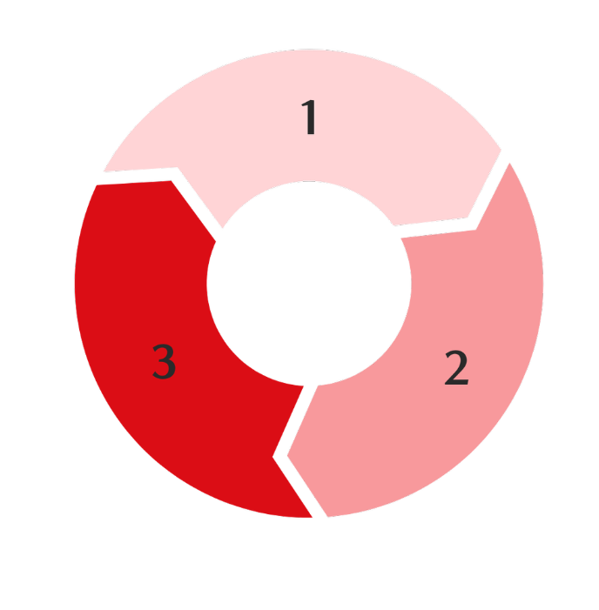
Benefits and Applications of the System
Inventory Management
Facilitates efficient tracking of lost and found items in various environments like schools and libraries.
Scalability
The system can be enhanced to include user login features and status tracking for a more comprehensive service.
Real-World Use
This system has practical applications in diverse areas, including educational institutions, airports, and community centers.

Slide 10

5
IIIustration of Use
For instance, entering ‘Phone’ retrieves information about both a lost phone in the library and a found phone in the cafeteria.

Slide 11

Match Results
When matches are found, the output displays both lost and found items alongside their respective locations.

Slide 12
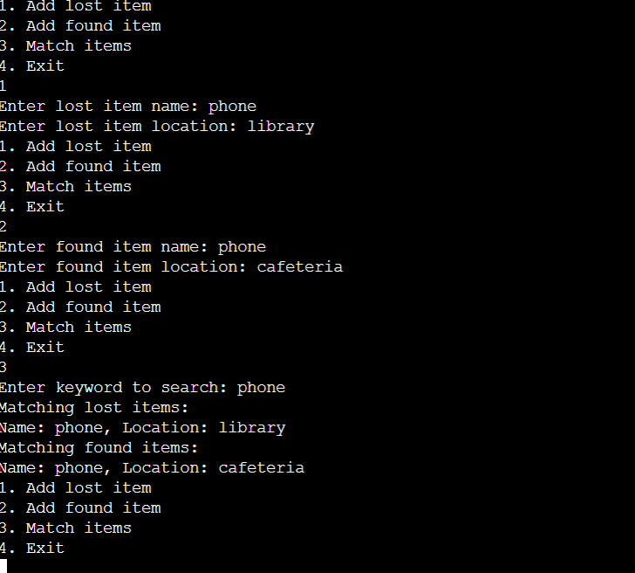
SOURCE CODE & OUTPUT
https://www.onlinegdb.com/eSZ82H1z2

Slide 13

Conclusion
This lost and found portal will allow systematic documentation of lost items and ensure delivery to the right owner. Moreover, it will reduce human efforts and provide proper management of data

Slide 14


